Slide 1
The Creative Power of Youth
Alexander Sun
11/14/2015

Slide 2
Engaging Youth in Planning Our Future

Slide 3
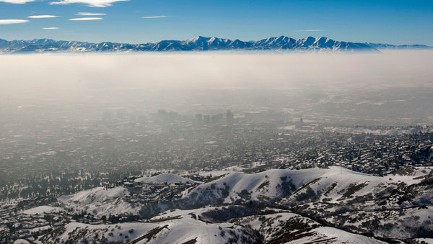
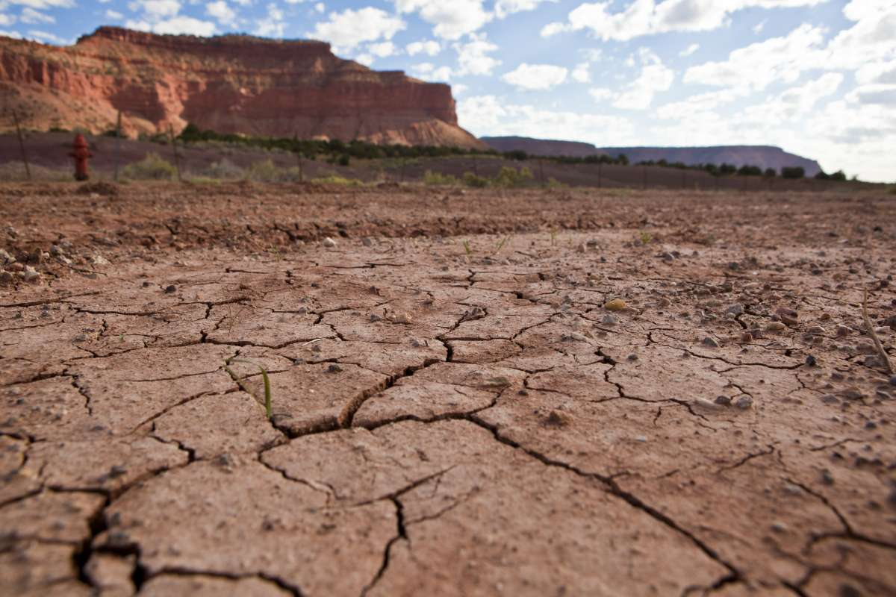
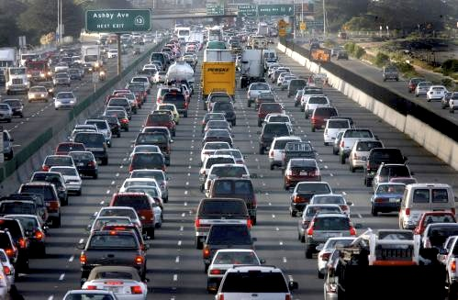

Slide 5
1990s Quality Growth Strategy
140 miles of rail added
70 stations
195,000 people within ½ mile of a rail station
2020 strategy goal: 700,000+
Notes:
Now, we don’t have to do these kind of improved land uses everywhere. People should have a choice about what kind of community they live in. But modeling shows that if we design our land uses right in key places, it makes a big difference. One of those places is around our rail stops. Today, we have about 200,000 people who can walk to a rail stop. With the right development in the right places, we can hit our Quality Growth Strategy goal of 700,000 or more by 2020. That doesn’t mean everyone has to live near a rail stop, but those who want to live and travel that way can.

Slide 6
Utah’s population will nearly double in size. Utah will not.
Notes:
Our state’s population has doubled in the last thirty years, and we’re projected to add another 2.5 million people by 2050, most of whom will be our own children and grandchildren. We all love our high quality of life, our beautiful natural surroundings, and our strong economy. To protect those things that we value about living here, we need to establish a vision together for our Utah.

Slide 7
Why should youth be involved in planning for the future?
We have the most at stake in the future
Teach students about the role of science and modeling in public policy
Motivate parents and other adults to get involved

Slide 8
Notes:
THEY WANT TO BE INVOLVED: Polls of adults show adults aren’t so sure who can successfully learn, grapple with the issues and complexity, and lead out in this field
We asked 600 or so high school students (through living polling) – they got to text in their answers during a live presentation.

Slide 9
Housing & Cost of Living
Education
Air Quality
Transportation & Communities
Agriculture
Economic Development
Disaster Resilience
Recreation
Water
Public Lands
Energy

Slide 10
Strategies for Youth Involvement
Technology
Social norms strategies
Piggybacking on existing youth organizations and activities

Slide 11
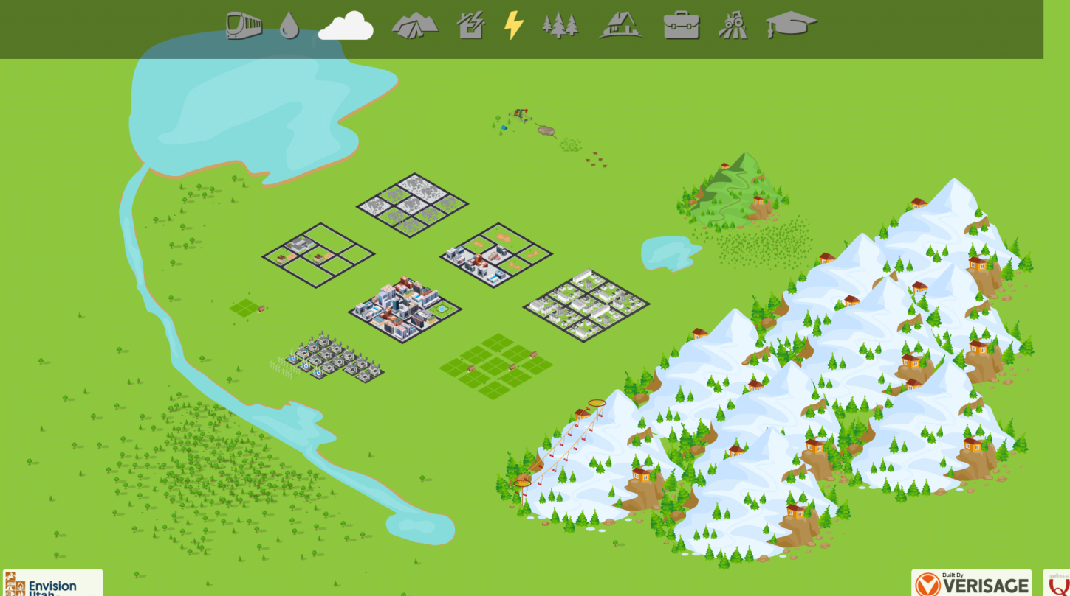
Technology: online game modules

Slide 12
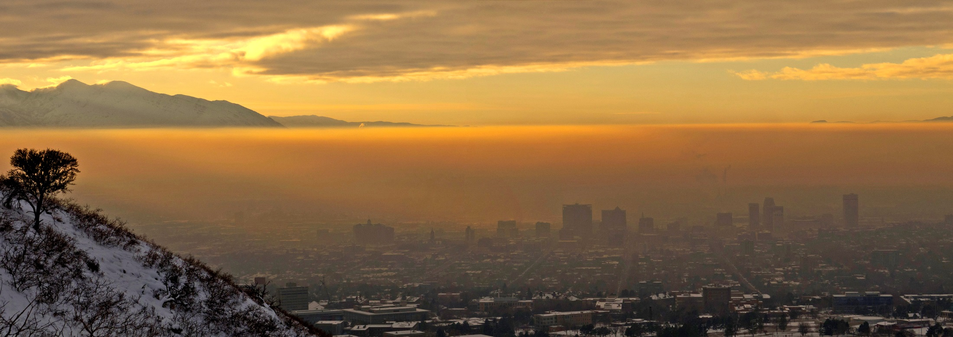
Air Quality
Notes:
Perceptions and reality

Slide 13
Sources of Air Pollution
Youth Perceptions
Actual Sources
Notes:
Significant gaps between perception and reality in terms of CAUSES and SOLUTIONS to Utah’s air quality problems.

Slide 15
Join your fellow students in the Envision Utah Youth Council

Slide 16
Youth responses to Social Norms
80.7%
67.5%
Respondents
49.4%
“75% of people donate”
“75% of 9th to 12th grade students donate”

Slide 17
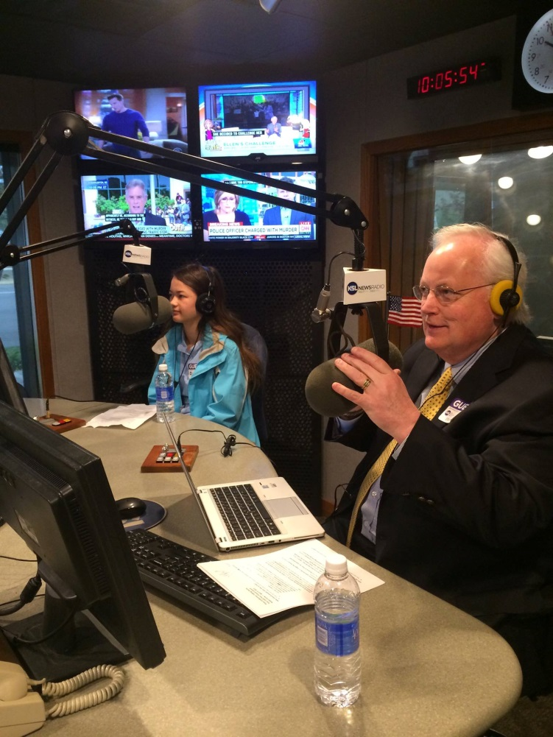
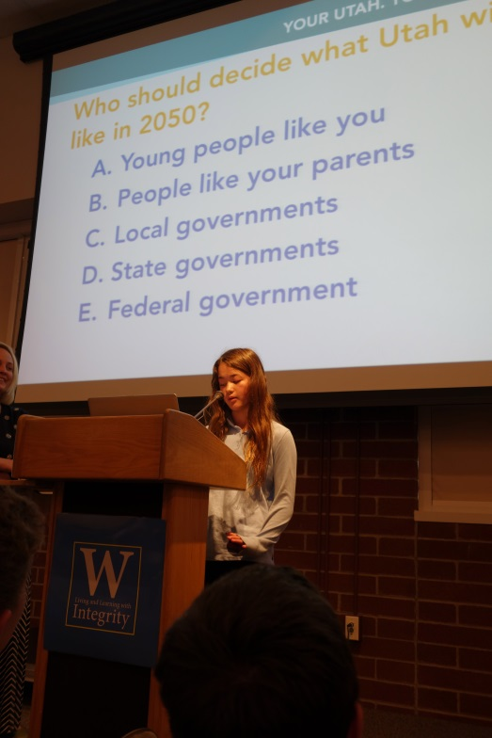
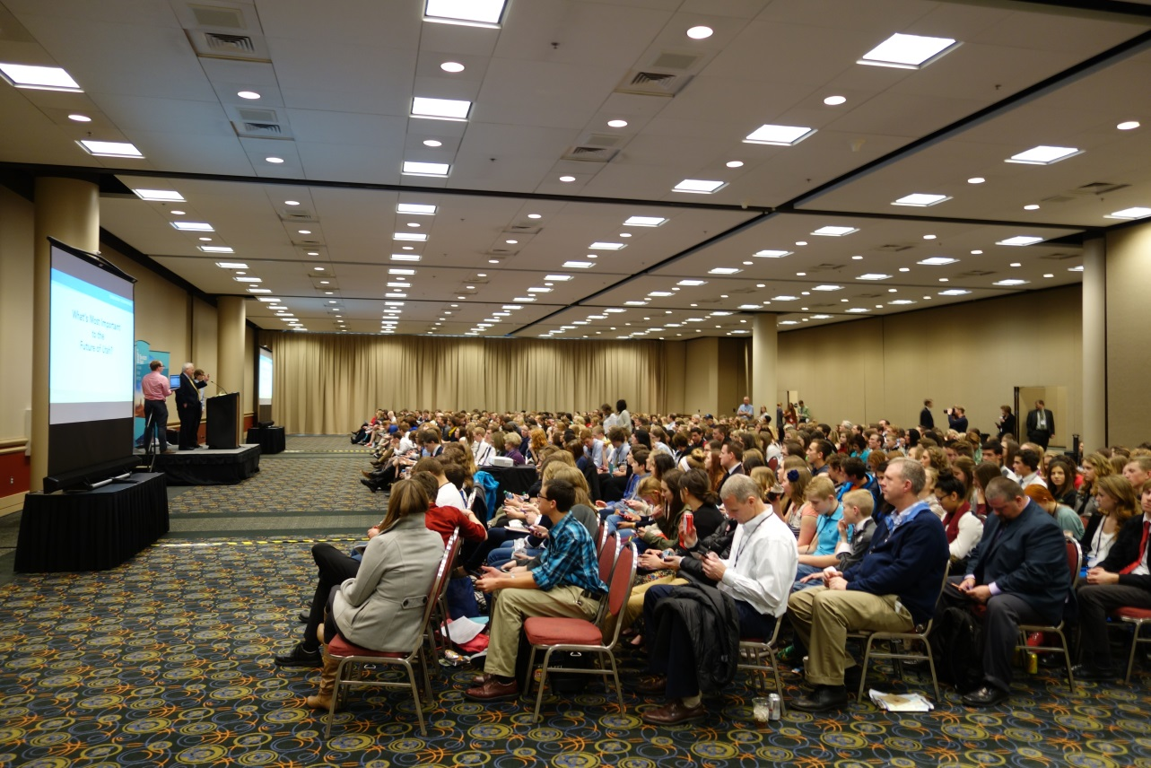
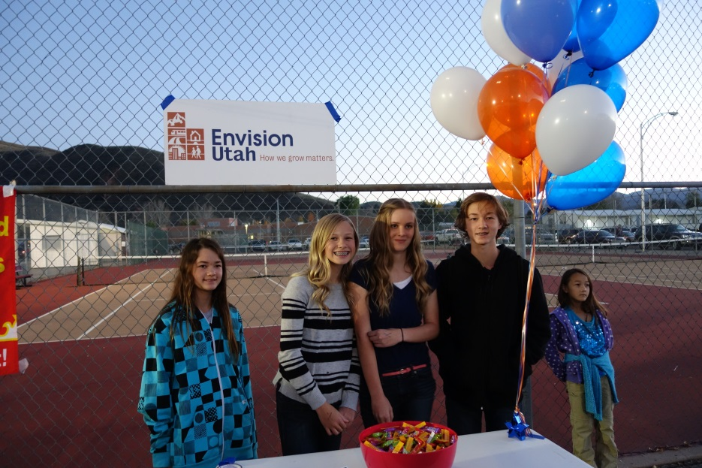

Slide 18
Envision Utah Youth Council
youthenvisionutah@gmail.com

